Slide 1

ARIANE 5 • FLIGHT 501 • 1996
01 / 09
THE $370 MILLION
LINE OF CODE
37 seconds that changed history
$370M
37 SECONDS
V88 / 501
◆
A system failure—not one line.
◆
Reuse met a new flight profile.
◆
Code reached the real world.
NOT A SINGLE LINE.
A CHAIN OF FAILURES.
WHEN CODE MEETS DESTINY
Source: ESA/CNES Ariane 501 Inquiry Board • 23 Jul 1996
Notes:
OPEN — ~30 seconds
June 4, 1996. Ariane 5 Flight 501 launches from Kourou.
Thirty-seven seconds later, it has lost guidance and the launcher breaks up.
The headline is often reduced to “a $370 million bug” or “one line of code.”
That is memorable—but technically incomplete.
The real story is a chain: reused software, a different flight profile,
an arithmetic overflow, inadequate exception handling, and a guidance-system failure.
This is the story of what happens when code meets physics.

Slide 2
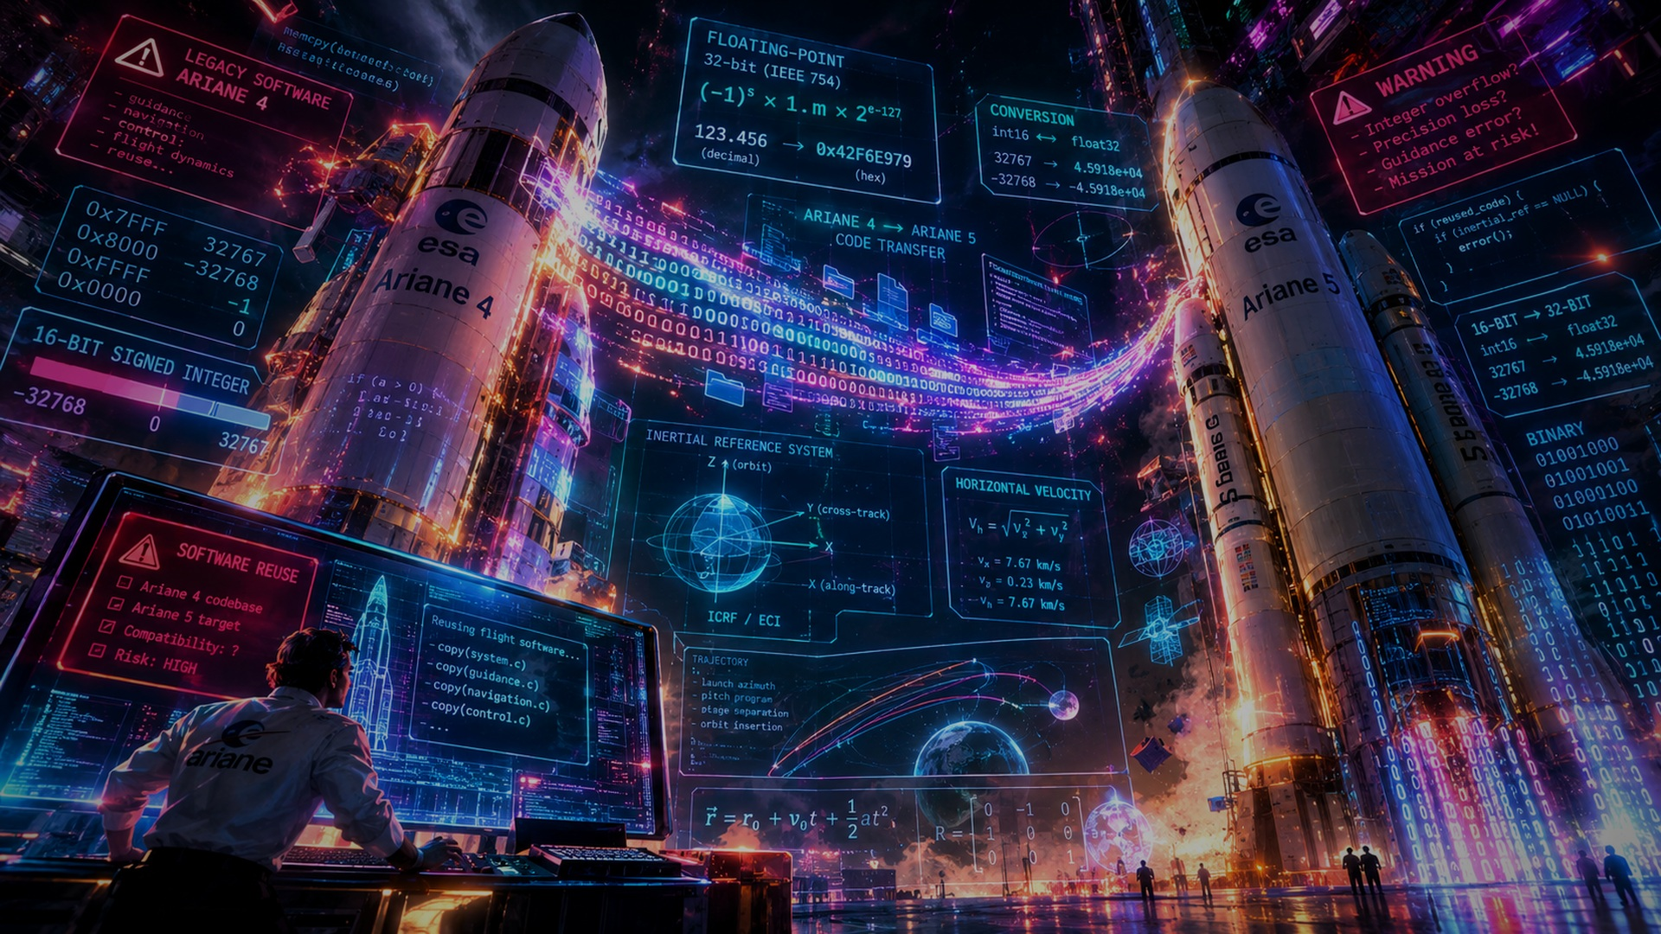
01 • REUSE
02 / 09
REUSE SAVED TIME
Until the rocket changed.
ARIANE 4
REUSE
ARIANE 5
CODE → CODE
◆
Ariane 4 software was reused.
◆
Ariane 5 flew differently.
◆
The assumption survived the migration.
WHEN CODE MEETS DESTINY
Source: ESA/CNES Inquiry Board • ESA Software Product Assurance
Notes:
~30 seconds
Ariane 4 had a long record of successful flights.
Its inertial reference software was therefore familiar, proven, and reusable.
But Ariane 5 was not simply Ariane 4 with more power.
Its flight dynamics were substantially different.
Part of the inherited software remained active even though its rapid
re-alignment function was not needed for Ariane 5's mission.
The dangerous assumption was not “reuse is bad.”
It was that software proven in one operating envelope would remain safe
in another without the same analysis and qualification.

Slide 3
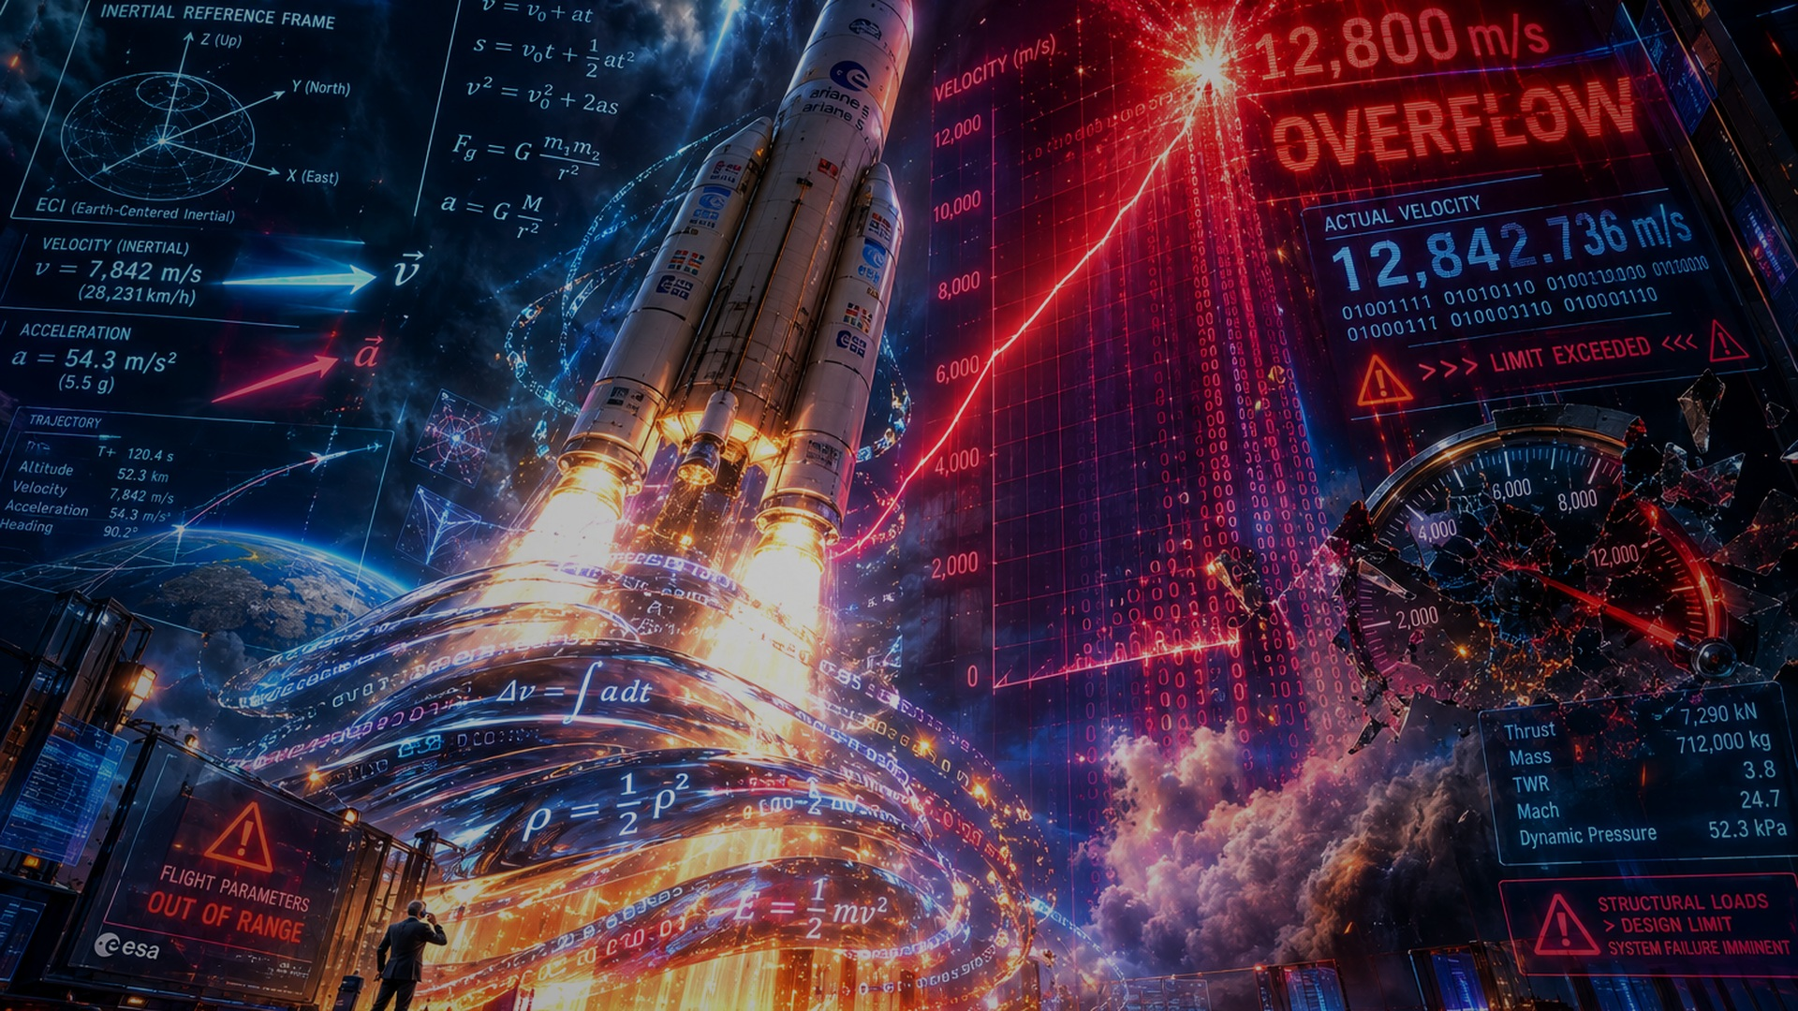
02 • PHYSICS
03 / 09
THE ROCKET CHANGED
The software didn't.
VELOCITY
16-BIT SIGNED INT
DESIGN LIMIT
OVERFLOW
v →
◆
Horizontal velocity rose faster.
◆
A 16-bit conversion had limits.
◆
The boundary was never exercised.
WHEN CODE MEETS DESTINY
Source: ESA/CNES Inquiry Board • technical postmortem summaries
Notes:
~35 seconds
Ariane 5's trajectory produced a much larger horizontal velocity than
the inherited software had encountered on Ariane 4.
A 64-bit floating-point value was converted to a 16-bit signed integer
inside the inertial reference system's software.
A signed 16-bit integer can represent only a limited range.
The value exceeded that range.
The key engineering lesson is not “integers are dangerous.”
It is that numerical assumptions are part of a system's operating envelope—and
that envelope changed.

Slide 4
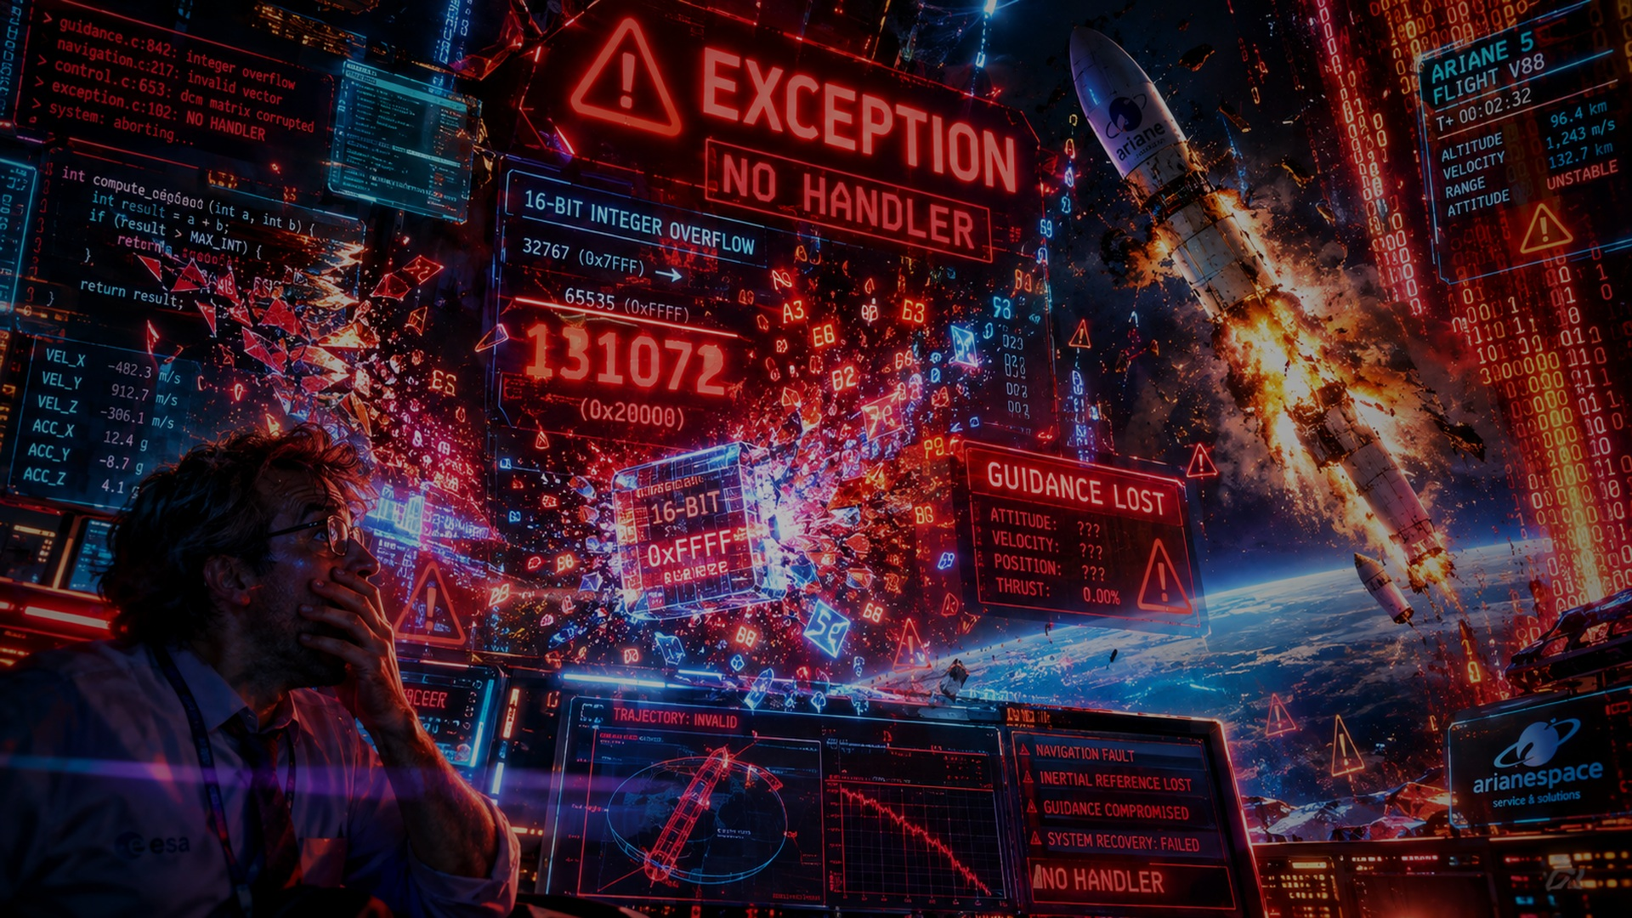
03 • FAILURE
04 / 09
THE OVERFLOW
The number became impossible.
EXCEPTION
NO HANDLER
GUIDANCE LOST
◆
Overflow triggered an exception.
◆
The handler did not recover.
◆
Both inertial systems failed.
WHEN CODE MEETS DESTINY
Source: ESA/CNES Ariane 501 Inquiry Board • 23 Jul 1996
Notes:
~35 seconds
The conversion overflowed.
The software detected the arithmetic exception, but the relevant handler
did not provide a recovery path for this condition. The inertial reference
system shut down.
Ariane 5 had redundant inertial reference systems—but both ran the same
software and encountered the same failure condition within milliseconds.
The redundancy therefore did not protect against a common software defect.
The onboard computer then received diagnostic data and interpreted it as
valid guidance information. The control commands drove the vehicle sharply
off its intended trajectory.

Slide 5
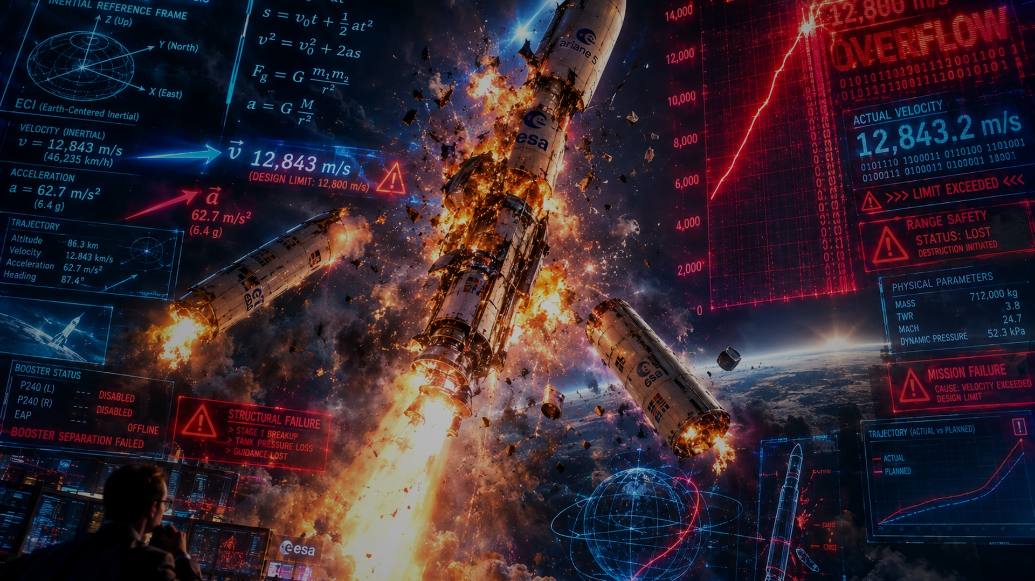
04 • CASCADE
05 / 09
37 SECONDS
From launch to destruction.
0s
≈37s
≈39s
LAUNCH
GUIDANCE LOST
BREAKUP
◆
0s — nominal launch.
ERROR
◆
≈37s — guidance information lost.
◆
Seconds later — breakup & self-destruct.
WHEN CODE MEETS DESTINY
Source: ESA/CNES • Flight 501 first information & Inquiry Board
Notes:
~35 seconds
For roughly the first 36 seconds, the flight was nominal.
At about 37 seconds, the inertial reference systems failed.
The resulting control commands sent the launcher sharply away from its
intended flight path.
Aerodynamic loads then caused the vehicle to break up.
Its flight termination system correctly destroyed the launcher after
loss of structural integrity.
So the rocket did not simply “explode because of an integer.”
The overflow initiated a chain of failures that reached the physical vehicle.

Slide 6
05 • AFTERMATH
06 / 09
THE FIREBALL WAS REAL
The software lesson was bigger.
~$370M
4 × CLUSTER
SYSTEM LESSON
◆
Four Cluster spacecraft were lost.
◆
~$370M of value was lost.
◆
The investigation exposed system gaps.
WHEN CODE MEETS DESTINY
Source: ESA/CNES Inquiry Board • 23 Jul 1996
Notes:
~30 seconds
The payload was ESA's four-spacecraft Cluster mission, intended to study
Earth's magnetosphere.
The loss was widely reported at more than 370 million US dollars.
But the investigation's most important conclusion was broader than the
arithmetic error: the development process had not adequately analyzed and
tested the inertial reference software in the Ariane 5 flight environment.
The lesson moved from “fix this bug” to “change how safety-critical software
is qualified, reviewed, and tested.”

Slide 7
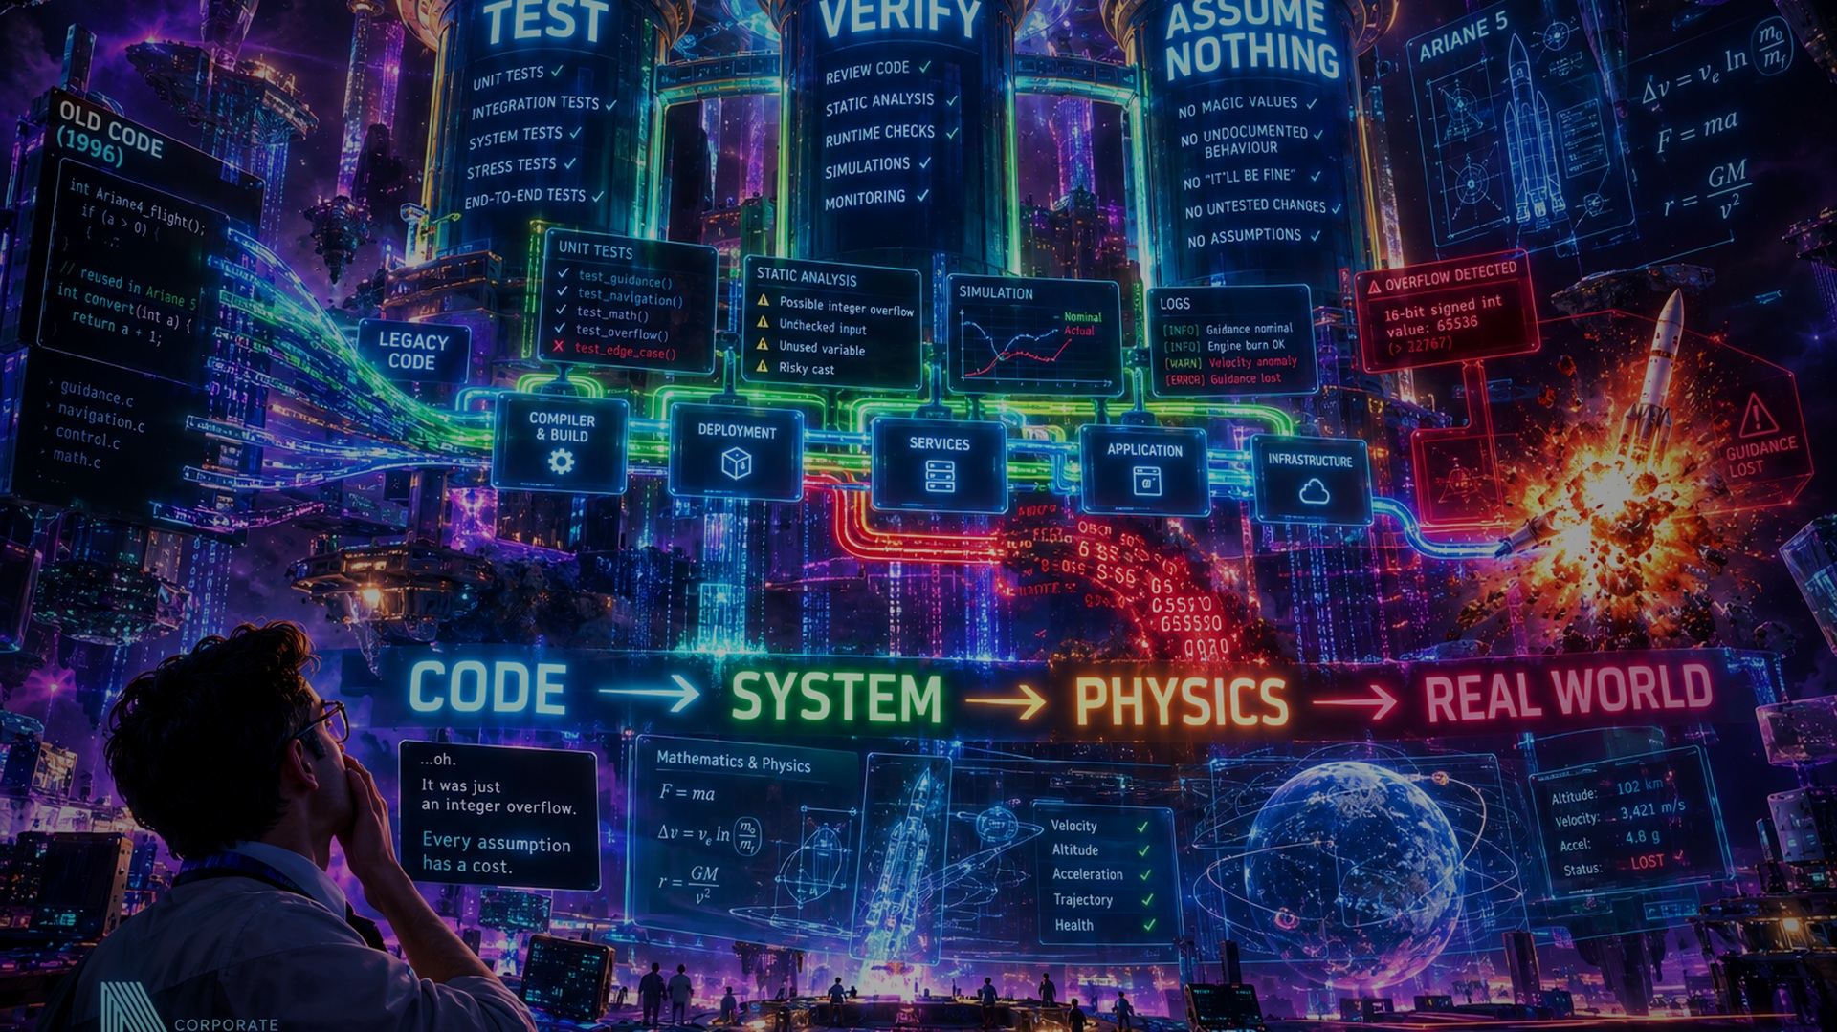
06 • LESSON
07 / 09
REUSE IS NOT FREE
Every assumption has a cost.
TEST
VERIFY
ASSUME NOTHING
CODE → SYSTEM → PHYSICS → REAL WORLD
◆
TEST the new operating envelope.
◆
VERIFY assumptions at boundaries.
◆
ASSUME NOTHING about inherited behavior.
WHEN CODE MEETS DESTINY
Source: ESA corrective-action plan • 11 Sep 1996
Notes:
~30 seconds
Software reuse can save engineering time and reduce duplicated work.
But reuse also imports assumptions.
The practical lesson is to test the new operating envelope, verify
boundary conditions, and explicitly review assumptions that were valid
in the old system.
For safety-critical systems, “it worked before” is evidence—not proof
that it works here.

Slide 8
07 • MODERN ENGINEERING
08 / 09
BUILD FOR CHANGE
Today's code meets tomorrow's world.
CODE
→
TEST
→
SIMULATE
→
DEPLOY
→
MONITOR
UNKNOWN INPUT
SAFE FAILURE
◆
Test boundaries, not just normals.
◆
Simulate failures before launch.
◆
Fail safely—and observe everything.
WHEN CODE MEETS DESTINY
Modern engineering synthesis • informed by ESA post-flight actions
Notes:
~30 seconds
Modern engineering turns the lesson into a workflow.
Test nominal behavior, but also test the edges.
Use static analysis to find impossible or dangerous conversions.
Inject faults deliberately.
Run simulations under the actual mission envelope.
Instrument systems so that failures become diagnosable.
And most importantly, define what “safe failure” means before the system
is under stress.

Slide 9
08 • FINALE
09 / 09
WHEN CODE MEETS DESTINY
Build software that survives reality.
INNOVATION
THANK YOU
Elevate stakeholder alignment.
Unlock cross-functional synergies.
Build better software.
Respect the edge cases.
“The future belongs to those who test it.”
WHEN CODE MEETS DESTINY
WHEN CODE MEETS DESTINY
Historical facts: ESA/CNES • Final line is presentation wording
Notes:
~30 seconds
Ariane 5 Flight 501 is remembered because the failure looks absurd in
hindsight: an arithmetic overflow inside old software contributed to the
loss of a new rocket.
But the deeper lesson is not about one integer.
It is about interfaces between code and reality.
When assumptions cross those interfaces, they need evidence.
The future belongs to engineers who test those assumptions before reality does.

